Slide 1
Bank Customer Churn Report
Analysis by Anwar Ansari

Slide 2
Bank Customer Data for Predicting Customer Churn
This data set is taken from Kaggle :-
https://www.kaggle.com/datasets/gauravtopre/bank-customer-churn-dataset

Slide 3
Objective
Objective: Analyzing Customer Dynamics and Behavior
1. **Total Number of Customers:**
- Obtain a comprehensive count of the total number of customers currently engaged with the bank.
2. **Customer Churn Percentage:**
- Calculate the churn percentage by determining the ratio of customers who have discontinued their
services to the total number of customers.
3. **Churn Rate:**
- Assess the churn rate, which is the frequency at which customers discontinue their association
with the business over a specific period, often expressed as a percentage.
4. **Customer Distribution by Gender:**
- Analyze the customer base by gender to identify any gender-based patterns or preferences.
5. **Active Status:**
- Determine the proportion of active customers to understand the current engagement levels and identify factors contributing to customer retention.

Slide 4
Objective
Objective: Analyzing Customer Dynamics and Behavior
6. **Credit Card Status:**
- Categorize customers based on their credit card status, differentiating between those who possess a credit card and those who do not.
7. **Customer Distribution by Credit Card Score Group:**
- Group customers based on their credit card scores to gain insights into creditworthiness patterns and assess the
impact on customer behavior.
8. **Identification of Important Locations:**
- Identify key locations or regions where customer engagement is notably high or low, aiding in targeted marketing and service improvement strategies.
9. **Customer Tenure:**
- Evaluate the average tenure of customers, providing insights into the sustainability of customer relationships and potential areas for improvement.
10. **Customer Churn Rate by Age Group:**
- Analyze the churn rate within different age groups to understand whether certain age demographics are more prone to disengagement.
11. **Age Group Distribution:**
- Categorize customers into different age groups to identify any age-related trends or preferences that may impact customer behavior.

Slide 5

**Total Number of Customers:**
10k

Slide 6
**Customer Churn No. and Percentage:** 2037 Customer Lost and 20.37% of our total Customer.

Slide 7

5457 Male and 4543 Female Our bank Customer.

Slide 8

5151 Active and 4849 are Non-Active customers in our bank.

Slide 9
7055 Customer owned Credit Card and 2945 are those customer who not owned Credit Card.

Slide 10
Most of the customer Credit Score are 601 to 800.

Slide 11
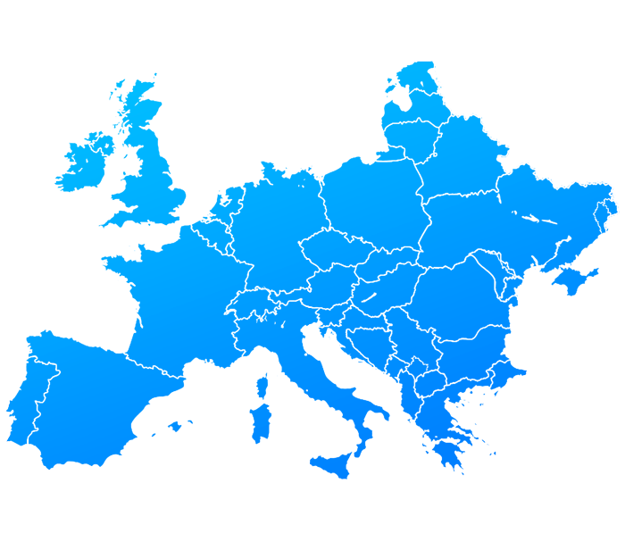
Our Customer belongs to Spain, Germany and France

Slide 12
Our customers stay with Bank Service for long-term tenure.

Slide 13

In Our Analysis 51-60 age Group of customers churn rate is so high.

Slide 14

In Our Analysis, the Customer Churn rate is very high. Take an Immediate Action to control them. Increase Female Customer in our bank. Provide more offers to the customer.

Slide 15
Thank You

